Slide 1
연구실 세미나 목차
발표자
제목
연구/논문
유재상
Product platform management strategy for pre-planned life cycle
연구 및 논문

Slide 2
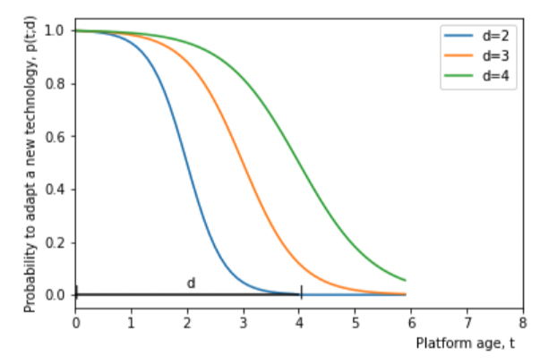
Research Objective
Is product platform properly used within pre-planned duration?
If pre-planned duration = 5
Reasons :
Relative obsolescence
Dynamic exogeneous factors
Internal complexity
Existing way :
→ Make flexible product platform design (config)
Need (release) management strategy
module selections from various candidates that deal with customer requirement - Need microscopic view of adaptability - Change management with unchangeable (= product platform) component
<Product platform replacement: impact of performance objectives, innovation speed, and competition >
< Chang Muk Kang , Yoo S. Hong & Woonghee Tim Huh (2012) Platform replacement planning for management of product family obsolescence, IIE Transactions, 44:12, >
Notes:
a long-lasting platform is prone to obsolescence and, thus, to becoming unsuitable for the adoption of state-of-the-art technologies.
1) 외부 효과가 너무나 dynamic 해서 design 단계에서 cover가 불가능
2) Product platform design 단계와 실제 그것을 사용하는 단계 사이의 격차로 인해, 모든 것을 다 담기가 불가능

Slide 3
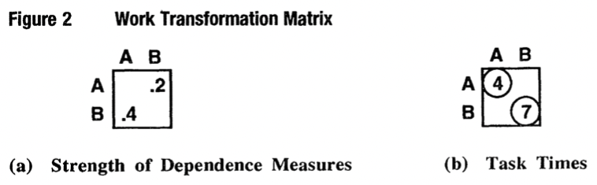
Methodology (naive)
Variant Com
Variant Com
Platform Com
Variant Com
(1)
(2)
Variant Com
Ex) FR : 회전축 속도 증가 + PC가 발열을 잡지 못함
Variant component 자체적으로 change를 흡수 → 더 높은 cost & duration 필요
PC와 인접한 다른 component에서 변화를 흡수
Platform과 인접한 variant component들의 더 많은 cost & duration (effort)을 요구 ➔ module selection에 따른 모듈별로의 adaptability 비교

Slide 4
현재 진행중인 사항 및 향후 계획
제 주장에 대한 구체적인 근거 찾기!
Product platform
Adaptability (obsolescence)
Release management
&
Microscopic
Change Propagation

